Slide 1

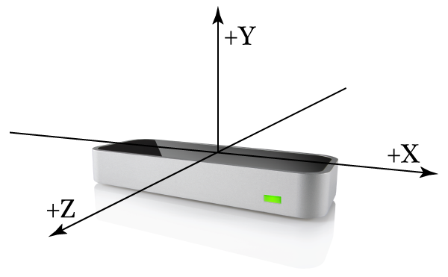
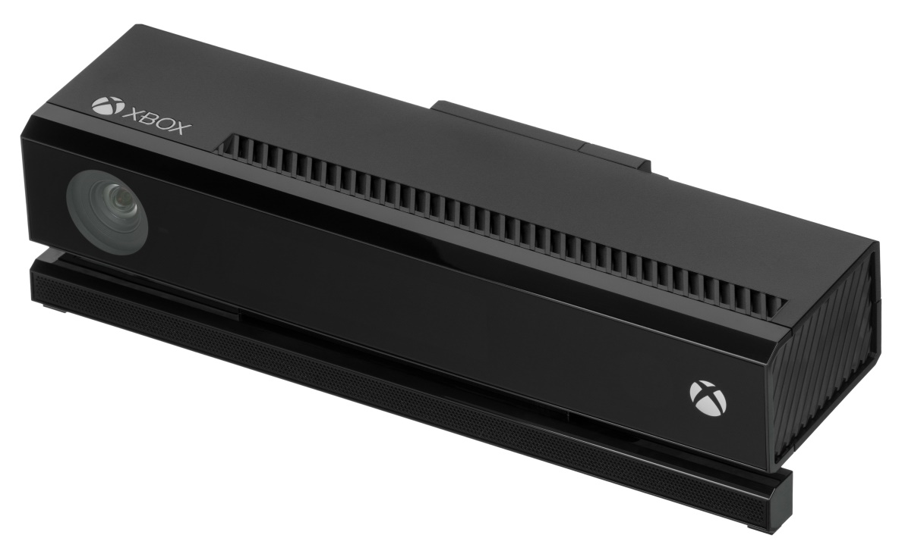
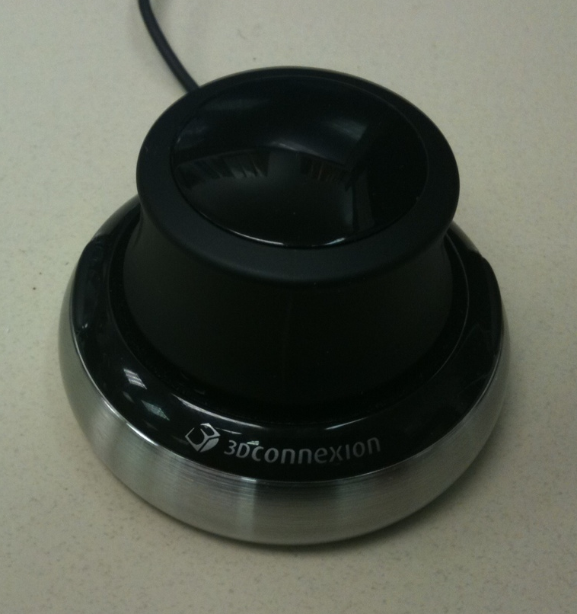
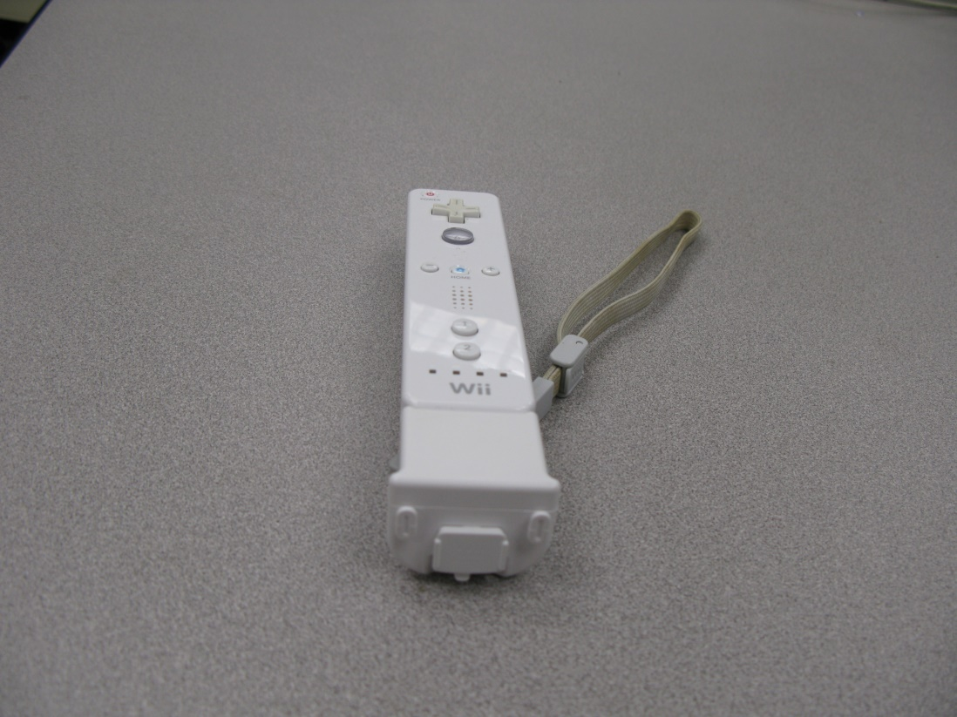
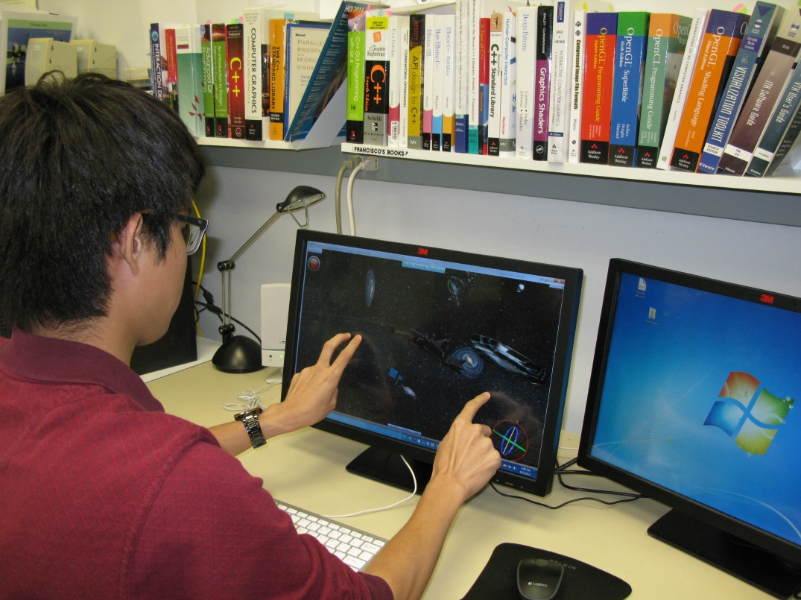
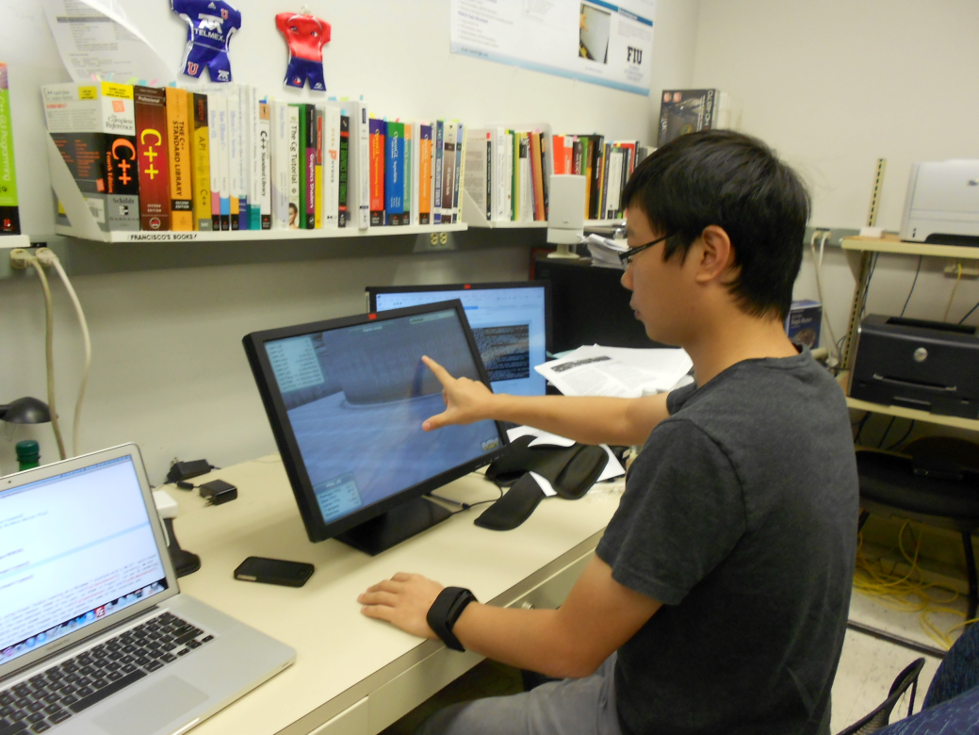
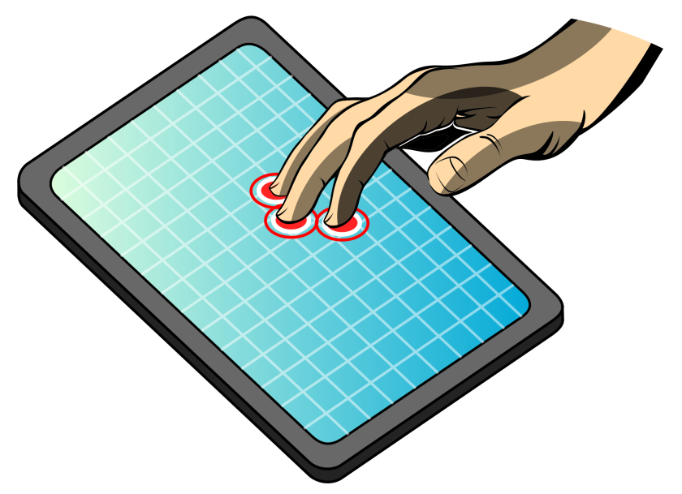
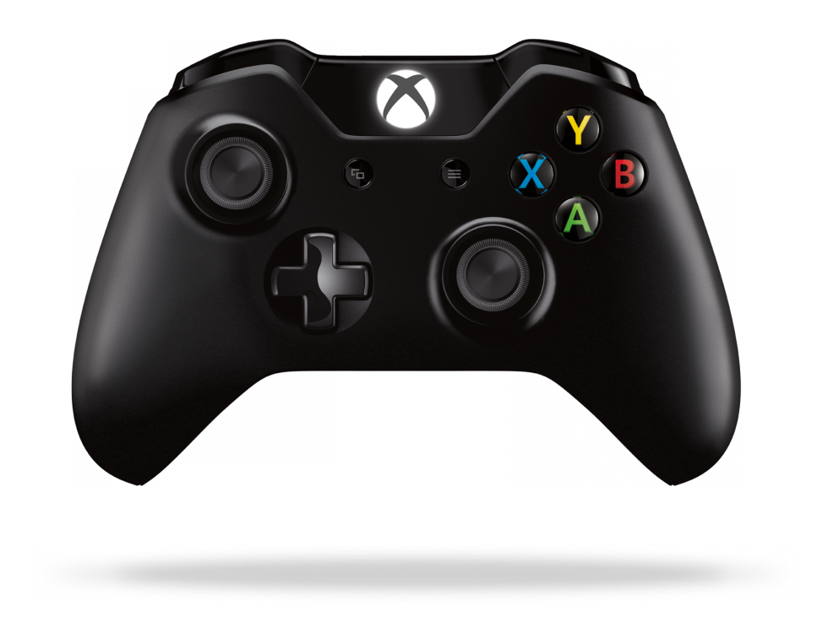
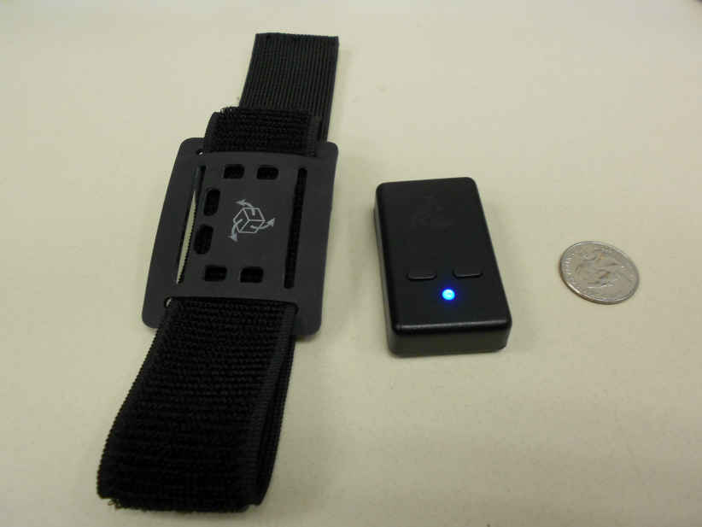
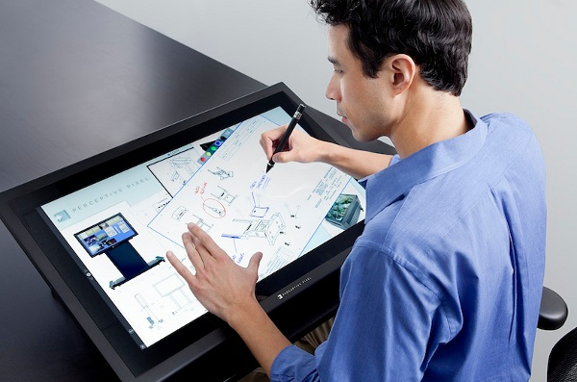
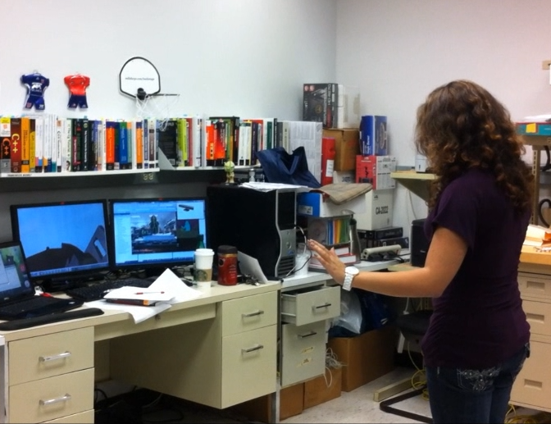
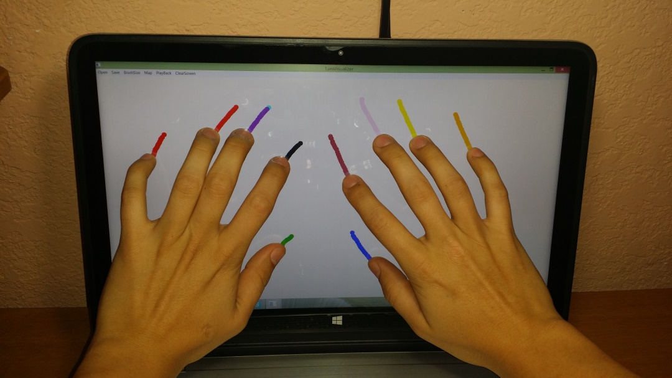


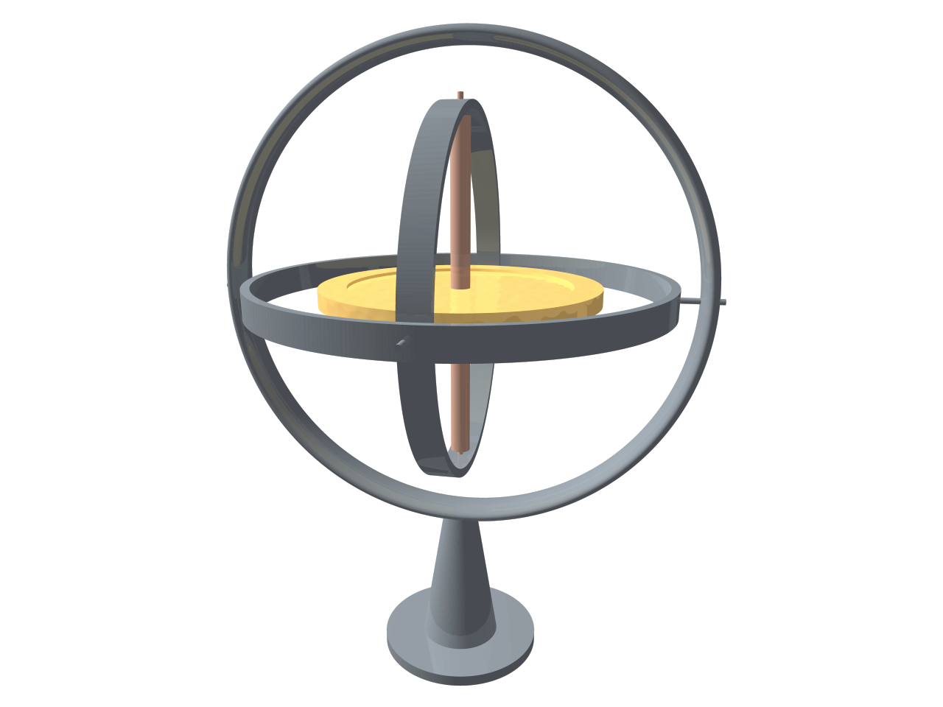
TAM: Touch and Mid-Air Framework
SPRING 2015
Spring 2015 Senior Project Student: Richard Lopez
Mentor: Francisco R. Ortega, Ph.D.
Sponsored By: Naphtali Rishe, Ph.D. and Francisco R. Ortega, Ph.D.
Class Professor: S. Masoud Sadjadi, Ph.D.
Why? Input Device Explosion
New User Interaction Paradigm
Motivation
Long Term Goals
Virtual Interfaces
Modern Input Devices
Explosion of New Input Devices
Multi-Touch, Leap-Motion, Kinect v2, etc..
Paradigm Shift
From WIMP to Post-WIMP
Modernize Code Base
Only one existing Active Open Source
VRPN (C-Based)
Designed For Client/Server
Some existing solutions for specific engines only
Promote Computer Science using HCI
Modern Input Devices are low-cost.
Promote K-12 & upper-education programming
Improved Diversity by promoting cool projects
Great for Out-Reach Programs
TAM Framework
Unified Input Framework.
Modular (e.g., Virtual Interfaces →)
Bindings for other languages.
Java, C#, and others.
Ready for Gam and Graphics Engines.
Unity, UDK, Ogre 2.1
Provide Testing Environment for Developers
Provide Experiment Research for Input Dev.
Code Base
Scripting Options (e.g., LUA)
Modern Code Base (C++ (C++11,14)
Design for Parallel Computing.
Fast and Reliable code with Unit Testing
Networking Ready
Uses Qt Framework for Visualization.
Cross-Platform
Current Visualization System
Modules (Long Term)
Drawing: The ability to test the input output relationship via a multi-touch screen
Mapping: Mapping the input to an output other than the one to one relationship of the real and virtual screen.
Input Recording: Recording of all the X and Y pairs that represent the input received by the touch screen, the id of the finger touching it, and the time at which this action happened.
PlayBack: Representing the input as a two dimensional drawing allowing for differentiation of fingers via different colors. The playback happens in the order the touch events happened from the user. At the end of the playback the replay data is erased to allow for more playbacks without the first events playing back.
Save Touch Points: Saving the touch points as data in a Comma Separated Value file, for playback of older events.
PlayBack from a File: Representing the input as a two dimensional drawing allowing for differentiation of fingers via different colors. The playback happens in the order the touch events happened from the user. this playback can be used for touch events that happened on previous sessions of the visualizer.
Resize Brush: Choosing different brush sizes to allow an ample range of testing options.
Clear: Clear the draw area of previous drawings.( this does not clear the temporary playback data)
Debug: A debug monitor to better represent the events happening at the time of the replay and input. Any output to the Standard Out is redirected to this console.
Modules
Visualization System for Developers
Virtual Interfaces
Reusable code (e.g., Manipulations)
User Gestures
Supports current state of the art
Experiment Module
A/B Testing.
Multi-Modal Interaction
Future Work
Next Semester
User Gestures
Continue Visualization System
Virtual Interface
Test additional input devices
Conclusion
Towards a robust Input Framework
Cross-Platform
Modular
e
Email: forte007@fiu.edu -- Web: FranciscoraulOrtega.com

